Slide 1
Database systems

Slide 2
1, The use’s of databases
1,1 / Fields
A field is, Piece of information gathered from a record that contains multiple sources such as,
A text field which would be used for first name and last name of an individual.
A date field which would be used for date of birth, time of venue.
A yes & no field which can be used if a song required two microphones, if a song had explicit lyrics.

Slide 3
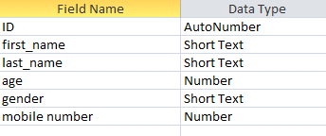
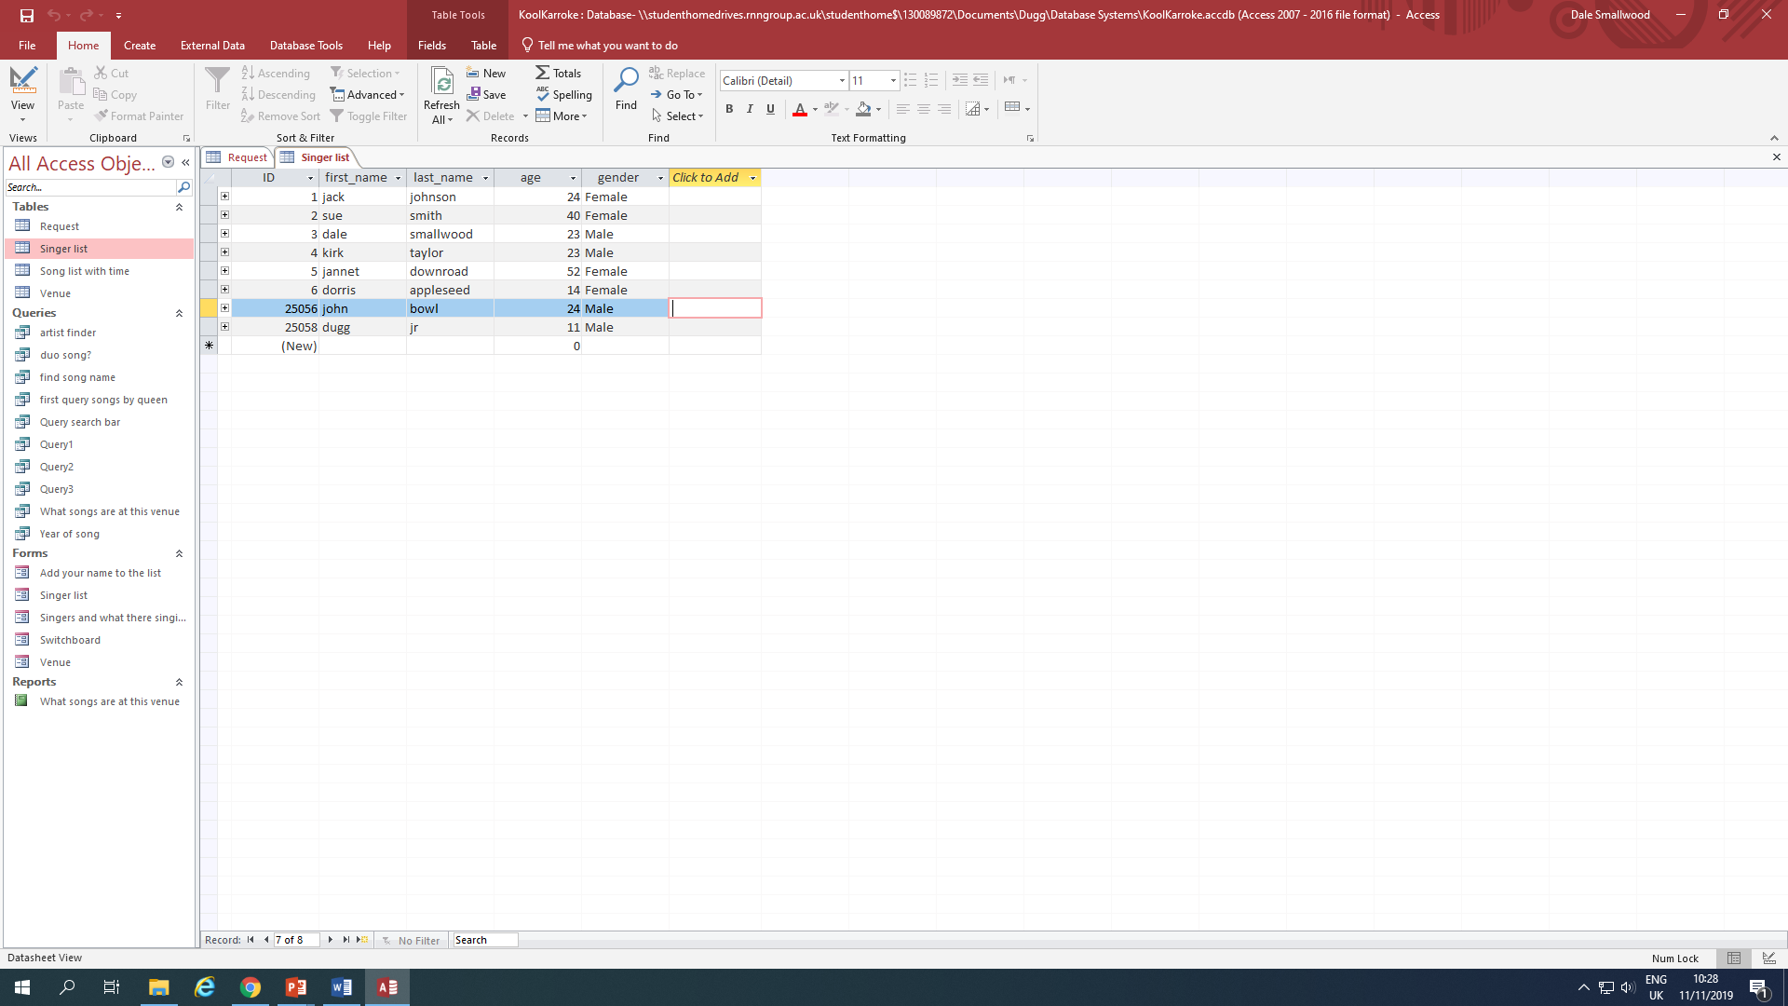
This screenshot provides evidence of a list of fields I personally used to make my database function.
This screenshot provides a functional table of information regarding on Koolkaraoke’s
guest singer list.

Slide 4
1.1 Table
A table is a collection of fields as shown on the previous slide showing the name, age and gender of a guest singer.
Another table which can be used is a list of songs, the artist’s name the length of a song and the genre.

Slide 5
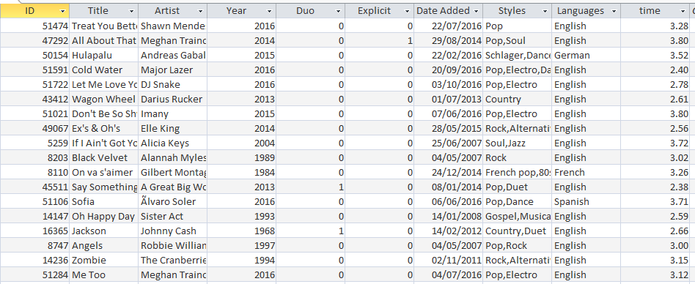
This screen shot shows a table of different available songs to play at the karaoke venue it also includes a Boolean if a song is explicit .

Slide 6
1.1 Relationships
A relationship in a database’s connects different tables together and prevents duplicate information such as, what a guest singer has chosen to sing and at what venue, it also supports making a set of quires function.
There is three different types of relationships which are
Many to many - A student has many teachers and a teacher has many students
Many to one - There are many students but only one school they attend
One to many - There is one headteacher and many teachers

Slide 7
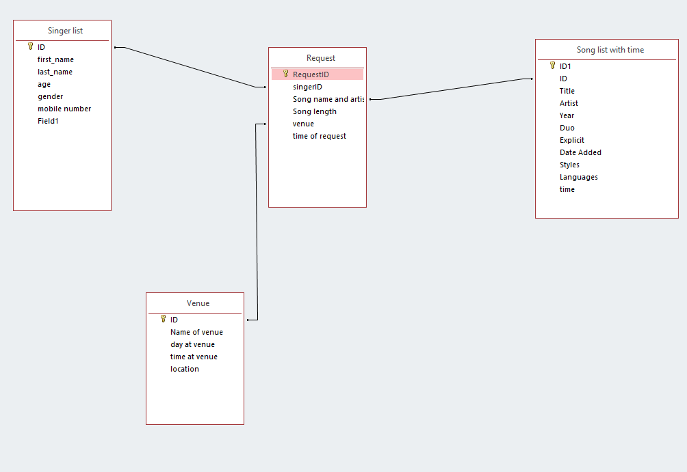
This is the relationship I have used for my database where it uses the id of each filed, this is simplified the information gathered.

